Slide 1

Robot nudgers. What About Transparency?
Stefano Calboli (Centre for Ethics, Politics and Society - University of Minho)*
* Position funded by Fundação para a Ciência e a Tecnologia (UI/BD/152568/2022)

Slide 2

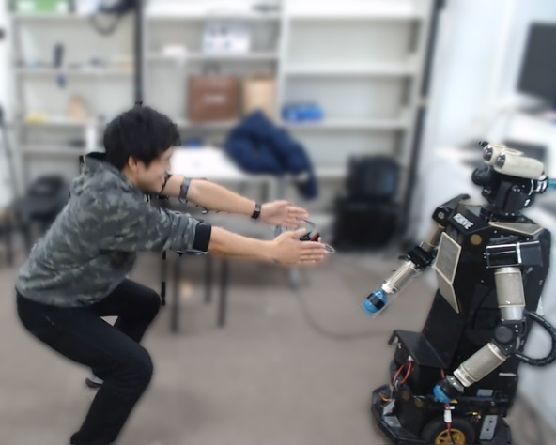
Outline
What nudges are (a working definition)
Nudges’ transparency
Robot-nudging and its ethics
Nudges’ transparency in Robot-nudging

Slide 3

What nudges are
The definition by Thaler and Sunstein (2008):
“Any aspect of the choice architecture that alters people's behavior in a predictable way without forbidding any options or significantly changing their economic incentives. To count as a mere nudge, the intervention must be easy and cheap to avoid. Nudges are not mandates”

Slide 4
What nudges are
This is too vague, here I adopt the term 'nudge' slightly more narrowly than Thaler and Sunstein:
A nudge does not forbid any options or significantly changing their economic incentives; it must be easy and cheap to avoid
AND takes into account the so-called system 1 (effortlessly, automatically, intuitively), one of the two fictional characters of Daniel Kahneman's dual-system account of mind
In this way, reiterating information cannot be no more considered nudging. Informing looks as a traditional and a well-established policymaking strategy, not as unconventional as nudges are described.

Slide 5

What nudges are
“takes into account the so-called system 1”...
1) Mitigate system 1-processes: encouraging deliberative processes to resist, or at least mitigate, the influence of system 1 (emotional arousal, cognitive flaws), promoting more careful considerations, eg. cooling off period.

Slide 6
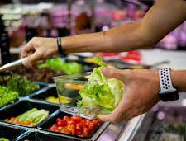

What nudges are
2) Leverage system 1-processes:
Cafeteria case
Strategies in food displaying. Fruits (rather than desserts) could be placed first down the cafeteria line and/or at eye level
Social norms - peer pressure
Our behaviors are conditional to what we think peers believe is fair to do and what we think peers factually do. Social norms affect our use of hotel towels (Goldstein et al. 2008), decisions facing economic games (Fischbacher et al., 2001), etc.

Slide 7
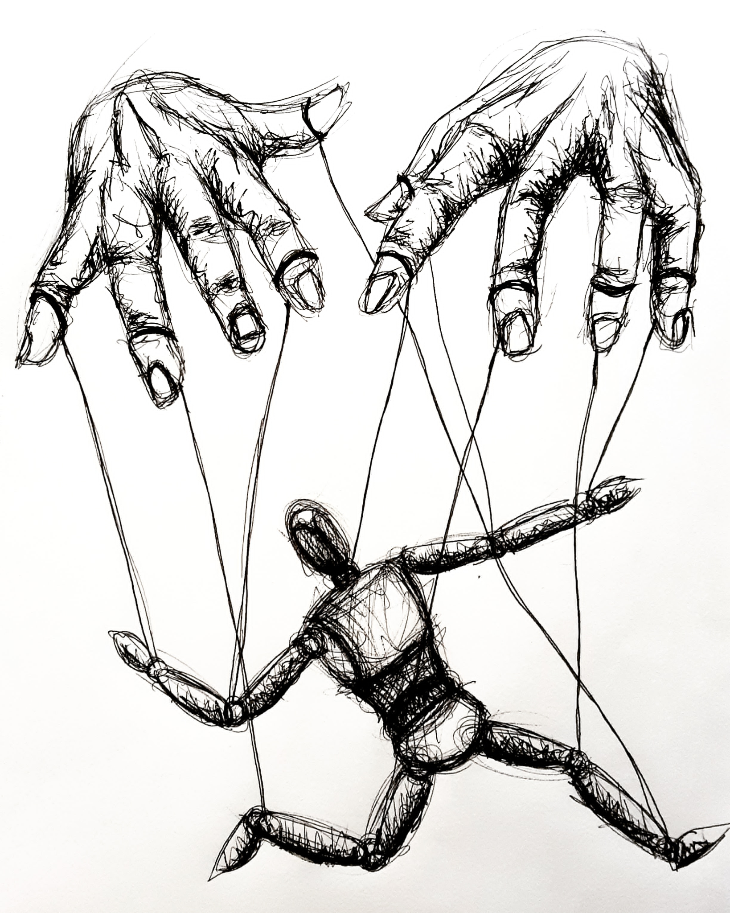
Nudges’ transparency
Nudges that leverage system 1-processes are ethically problematic:
System1-leverage nudges exploit automatic mechanisms wired deep into our cognition: nudgees are typically unaware of the influences exerted by such mechanisms
The prominent objection to nudging concerns the allegedly subtle manipulation (alien control) imposed by the nudgers on the nudgee
Notes:
A b c

Slide 8
Nudges’ transparency
The debate on how to defuse alien control is not settled, but all positions involve transparency:
Nudgees detect nudges, provided they are watchful (individual cognitive efforts)
Explicit transparency is needed (explicit communication)
What matters here is that legitimately employed nudges can be factually detected (transparent). When it is so, psychological reactance could emerge: “The unpleasant motivational arousal that emerges when people experience a threat to or loss of their free behaviours" (Steindl et al. 2015)
Psychological reactance potentially compromises nudges' strength: the nudgee could deviate from the behaviour targeted.
Notes:
A b c

Slide 9
Robot-nudging and its ethics
Robots can be and factually already are nudgers:
Ali Mehenni et al. (2021) experimented nudger dialogue systems as Pepper among children
Hang and colleagues (2021) investigated if, as in H-H interactions, even in R(nudger)-H interactions nudges has a positive effect on altruism
Rea, Schneider and Kanda (2021) developed a robot to test (im)polite sentences in encouraging users to exercise better. A possible further version based on peer pressure-sentences: «The majority of users at your age work harder than that!».

Slide 10
Robot-nudging and its ethics
The debate on the ethics of robot-nudging is scarce, though not absent:
In 2017, the Institute of Electrical and Electronics Engineers Standards Association established the Ethically Driven Nudging for Robotic, Intelligent and Autonomous Systems committee
In 2020, the team Affective and social dimensions in the spoken interactions led by Laurence Devillers, along with other colleagues, launched the Bad Nudge - Bad Robot? program aimed to delve into the risk posed by nudges to the more vulnerable people.

Slide 11

The ethical consequences of robot-nudgers’ design
The literature on robot-nudging's ethics can be roughly divided into two macro-areas:
One is devoted to ethical concerns linked to the behavioral goals robot-nudgers should help to achieve:
Klincewicz (2019) on stoic ethics
Borenstein and Arkin on promoting social justice (2015)
Howard and Sparrow (2021) on nudging sexual behaviours

Slide 12
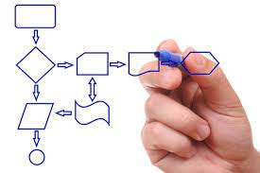
Robot-nudging and its ethics
The second macro-area addresses the ethical questions raised when nudging processes are considered:
Borenstein and Arkin (2015) discussed the kind of control on nudges' aims that should be granted to nudgees
Rodogno (2020) points out how social robots, as opposed to human nudgers, could promote behavioral changes influencing users' overall cognitive and affective states.

Slide 13

Nudges’ transparency in Robot-nudging
Our contribution concerns the process and modalities of nudging and how they affect the strength of nudges. We focus on transparency in robot-nudging, a somehow surprisingly overlooked aspect.
I provide starting points to integrate issues related to transparency within the debate on the ethics of robot-nudging. Two broad ethically relevant point

Slide 14
Nudges’ transparency in Robot-nudging
Customizations (of nudge)
In human-human interactions, nudgers typically implement nudges to modify univocally the choice environment (cafeteria example): At most, nudgers tailor nudges' influence at sub-group level (Page et al. 2020: reminder text messages to apply for receiving federal student aid)
With robot nudgers is another matter: robots are tools able to customize their actions in accordance with the specific user. E.g. The degree of detailing in identifying the exact reference network when peer pressure is exploited can be virtually customized to an individual level.

Slide 15

Nudges’ transparency in Robot-nudging
Customizations (of transparency)
Individual level customization also regards the kind and degree of transparency granted to nudgees. Considering robots, customized transparency is available.

Slide 16
Nudges’ transparency in robot-nudging
Customization raises several questions ethically relevant:
Who should be in charge of the setting of nudges and their transparency? Should be the nudger or the nudgee? How to solve eventual conflicts? E.g. the nudgee could prefer a version of transparency for which the burden to detect and comprehend nudge is totally on her; contrariwise, the nudger could retain more suitable to take charge of that burden.

Slide 17
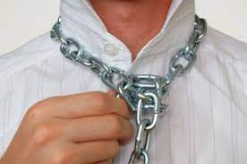
Nudges’ transparency in robot-nudging
Customization raises several questions ethically relevant:
In any case, are there options that should be forbidden being ethically improper?
Scenario 1: an obese person relies upon the help of a robot-nudger to lose weight. She is persuaded, rightly or wrongly, that transparency would impede her from reaching the aim and consequently opt for a complete and irrevocable opacity of nudges (Millian case of self-enslavement)

Slide 18

Nudges’ transparency in robot-nudging
Customization raises several questions ethically relevant:
Scenario 2: The nudgee prefers, for whatever reason, that the burden required to detect nudges' influence is totally on the nudger's shoulders. A full range of information should be released by the robot. It could be well the case that such kind of maximum transparency would impair the relationship between nudgees and robot-nudger.

Slide 19
Nudges’ transparency in robot-nudging
Enhancement of nudging
Robots can enhance their ability to nudge; they can indeed be programmed to collect data in order to profile the nudgee, to identify the most effective mix between nudges and transparency (best timing: circadian rhythms - Park et al. 2010)
Should robot nudgers be programmed to collect data to profile nudgees? An open question

Slide 20

Nudges’ transparency in robot-nudging
Enhancement of nudging
Perspective 1: An unmissable opportunity (once assumed that privacy issues can be overcome). i) The data would help nudgees to independently achieve their behavioral goals by identifying the choice environments helpful to do so, ii) Would make robot nudgers able to suggest nudgees on how to shape choice environments

Slide 21
Nudges’ transparency in robot-nudging
Enhancement of nudging
Perspective 2: Severe side effects lurk. The feeling to be observed and monitored could indeed easily result in psychological reactance, namely the "unpleasant motivational arousal that emerges when people experience a threat to or loss of their free behaviors [...; this] results in behavioral and cognitive efforts to reestablish one's freedom" (Steindl et al. 2015, p 205). Unfortunately, it is the primary concern regarding nudges' transparency. The H-R interactions could result compromised.

Slide 22
Even though these ethical issues should be high on the agenda of roboticists and ethicists, factually, they are not. Hopefully, the present work will encourage taking steps in this direction and inspire scholars to systematically explore transparency in robot-nudging.

Slide 23
Thanks
calbolistefano@gmail.com
This result seems to cast shadows on the uncanny robot-nudgers' ability to nudge successfully.

